Slide 1
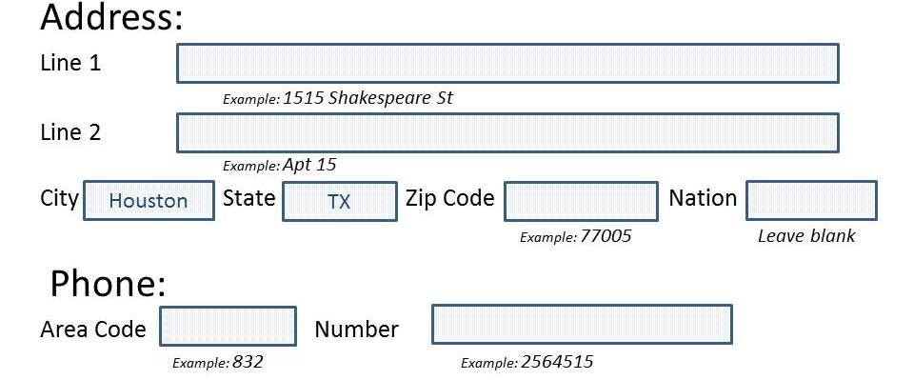
Local Address Update
All international scholars must enter their local Houston address in ESTHER (https://esther.rice.edu/) within 10 days of their start date at Rice University and anytime their address changes while here in the U.S. to stay in compliance with the immigration requirements.
(Don’t use any punctuation)
(If you live in a house, not an apartment, leave blank)
Directions on Updating your Address in ESTHER:
a) Go to https://esther.rice.edu/ (if this is your first time, follow the steps below)
- User ID: (your employee ID #, including the letter“E)
- PIN: your date of birth in MMDDYY format)
- Click login
- Re-enter Old PIN: (your date of birth in MMDDYY format)
- New PIN: create a new PIN that has not been used in the past 6 months (alphanumeric, 6-15 characters, containing at least 1 number)
- Re-enter new PIN
b) Login to your account
c) Click on Update Addresses and Phones
d) Write your local address information in the "Mailing Address" field (if you do not have a "mailing address" field, you update "permanent address" field)
e) Click on Submit
OISS will then receive an electronic update of your address.
If you have questions please contact Elmira Ganiyeva at eg18@rice.edu.

